Slide 1

LIP TO SPEECH SYNTHESIS
Batch Id : BE2102-20
Project Supervisor : Asst.Prof G Kavita
Project Coordinators : Associate Prof T Sridevi, Asst.Prof E Kalpana
By,
Jayanth Vunnam – 160118733100
Venkata Ajay Kumar Kadiyala - 160118733119

Slide 2
Abstract
Lip to Speech Synthesis is a deep learning project where it solves the problem of disturbance in a video by generating the speech from the lip movements of the speaker. In a video the speech can be corrupted by external noise or the voice is absent and this can be solved by lip to speech synthesis.
This can be achieved by training the deep learning models on hours of videos of individual speakers using large vocabulary settings. It detects the speaker and then learns the lip movements of speaker and learns from it. It is a difficult task as many words are pronounced same or silent letters in words and these difficulties are to be taken care and this can be improved by training on large datasets and large vocabulary which have many words and learns accurately.
We use various deep learning models like CNNs and Alex Net architecture for accurate speech detection and generates the speech. This project helps to generate speech from videos without sound and speech from people in camera under surveillance and helping people who cannot produce sounds.

Slide 3
Introduction
Humans tend to infer parts of the conversation from lip movements when speech is absent or corrupted by external noise.
Due to internet connection the speech may get disrupted will can lead loss of information.
In CC Cameras even if we have the option to record audio it may not be accurate and the audio will not be clear for people distant from it.
Due to this there will be Limited Accessibility to activities and loss of Information.

Slide 4
LITERATURE SURVEY
[1]. “Speech Reconstruction with Reminiscent Sound via Visual Voice Memory”. The goal is to reconstruct speech from silent video using Visual Voice Memory to store crucial audio data and synthesize correct speech from various speakers. The memory stores audio context as a key value pair from the input face movement and can be used again when similar movement occurs. It is used in multi-speaker video to assist produce high-quality speech.
[2]. “Tal: A Synchronized Multi-Speaker Corpus of Ultrasound Tongue Imaging, Audio, and Lip Videos”. Speech recognition, speech synthesis (articulatory-to-acoustic mapping), and automatic ultrasound to audio synchronization are all included. The corpus contains 24 hours of parallel ultrasound, video, and audio data, of which about 13.5 hours is speech. TaL1 is a series of six recording sessions of one professional voice talent.

Slide 5
LITERATURE SURVEY
[3]. “Automatic Voice Synthesis System using Long Short-Term Memory and Google Media pipe”. It uses the Google Media Pipe Library to extract face landmark-based features and then trains with a Long-Short-Term-Memory (LSTM) network. This model uses an LSTM model to detect 40 important points from a recognized face. It's for people who have lost their voices due to injury to their vocal cords or other factors.
[4]. “Speech Enhancement System Using Lip-reading”. The system created is for laryngectomee. They conducted interviews with people to learn about their problems and how current technology can aid them. In most cases, an external device is required, but they designed an application using the smart phone platform without one. They investigated a lip-reading approach that can recognize by registering the words that you want to utter using little amounts of data employing VAE and CNN models as the fundamental notion of the suggested system.

Slide 6
LITERATURE SURVEY
[5]. “Lip2Audspec: Speech Reconstruction from Silent Lip Movements Video”. A deep neural network that uses silent lip movement films to recover understandable speech. Auditory spectrogram as a spectrum representation of speech and its associated sound generating technology result in reconstructed speech that sounds more natural. An autoencoder extracts information from the auditory spectrogram, which is then used as a target for our primary lipreading network, which includes CNN, LSTM, and fully connected layers.
[6]. “A Novel Task-Oriented Approach toward Automated Lip-Reading System Implementation”. The concept of visual speech recognition was inspired by human experience: we can recognise spoken words by looking at a speaker's face without or with limited access to the sound element of the voice. We build autonomous visual speech recognition systems from the ground up using three different architectures: GMM-CHMM, DNN-HMM, and pure End-to-end. The current paper includes a detailed discussion of the approach, tools, step-by-step development, and all relevant parameters. It's worth noting that such systems were developed for the first time for Russian voice recognition.

Slide 7
LITERATURE SURVEY
[7]. “An Experimental Analysis of Different Approaches to Audio–Visual Speech Recognition and Lip-Reading”. They looked at many techniques to audio–visual speech recognition, such as Tree audio–visual modalities integration methods, such as GMM-CHMM, DNN-HMM, and end-to-end approaches, which were defined as the most promising and often found in scientific literature. It was carried out on the GRID corpus for English and the HAVRUS corpus for Russian. The obtained results support the advantage of neural network approaches over alternative approaches when there is enough data to properly train NN models, as evidenced by our studies on the GRID dataset.
[8]. “Dictionary-Based Lip-Reading Classification”. They are working on developing a robust technique for lip reading classification that uses EMPCA feature extraction and k-nearest-neighbor classification to extract the lips in a colour image. Lip motion is defined by three templates that are modelled based on different mouth forms in order to reduce the dimensionality of the feature space: closed template, semi-closed template, and wide-open template.

Slide 8
LITERATURE SURVEY
[9]. “Speech Training System for Hearing Impaired Individuals Based on Automatic Lip-Reading Recognition”. This paper uses CNN and RNN to build a speech training system for hearing impaired and dysphonic people. They practised communication skills by comparing the mouth shapes of hearing-impaired people and healthy people. There are four sections of training. First, they developed a voice training database that includes normal people's mouth forms as well as sign language vocabulary.
[10]. “Lip reading with Hahn Convolutional Neural Networks”. The major goal of this project is to create a video-based visual speech recognition system. It is utilised in the medical field to help people with laryngectomees. We employ the Hahn Convolutional Neural Network (HCNN), a novel architecture based on Hahn moments as the first layer in the Convolutional Neural Network (CNN) architecture, to reduce the dimensionality of video images and gain training time. The HCNN model has been trained to recognise letters, digits, and words in video images. We tested the suggested technique on three datasets: AVLetters, OuluVS2, and BBC LRW, and found that it delivers considerable results when compared to previous research.

Slide 9
METHODOLOGY
CNN:
A convolutional neural network, or CNN, is a deep learning neural network sketched for processing structured arrays of data such as portrayals.
CNN are very satisfactory at picking up on design in the input image, such as lines, gradients, circles, or even eyes and faces.
This characteristic that makes convolutional neural network so robust for computer vision.
CNN can run directly on a underdone image and do not need any preprocessing.
The strength of a convolutional neural network comes from a particular kind of layer called the convolutional layer.
CNN contains many convolutional layers assembled on top of each other, each one competent of recognizing more sophisticated shapes.
Keras Conv2D is a 2D Convolution Layer that generates a tensor of outputs by winding a convolution kernel with the layers input. Kernel: In image processing, a kernel is a convolution matrix or mask that can be used to blur, sharpen, emboss, identify edges, and more by performing a convolution between a kernel and an image.

Slide 10
METHODOLOGY
Alexnet:
AlexNet was the first CNN which used GPU to boost performance.
1. AlexNet architecture consists of 5 convolutional layers, 3 max-pooling layers, 2 normalization layers, 2 fully connected layers, and 1 softmax layer.
2. Each convolutional layer consists of convolutional filters and a nonlinear activation function ReLU.
3. The pooling layers are used to perform max pooling.
4. Input size is fixed due to the presence of fully connected layers.
5. The input size is mentioned at most of the places as 224x224x3 but due to some padding which happens it works out to be 227x227x3
6. AlexNet overall has 60 million parameters.

Slide 11
Proposed System
The video of a human's lip expression is caught. A video to frames converter is used to convert the video to frames. The input image is taken from the average frame. As a result, pre-processing operations such as ROI segmentation to eliminate the background are performed on the obtained pictures. The method of finding the face region in an image is known as face detection. The RGB to grey conversion procedure is used to convert the RGB face image to grayscale. The Lip is the actual ROI component.
The Lip is then recognized and retrieved from the Face using orientation (region) estimation. The different lip expressions of humans were categorized based on the selected features and measured area attributes of the lip. The individual words are displayed on the screen, and the voice notes that correspond to them are played. As a result, the human's lip movement was recognized.

Slide 12
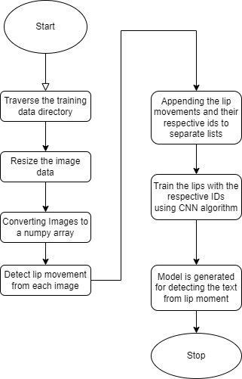
Proposed System
Block Diagram:

Slide 13
Data set Description
The MNIST dataset, which contains lip images in folders, is used to import some data. Data is also gathered via transforming films of specific words into photos, as well as identifying and preserving lips from images.
For the deep learning model to be trained, the raw video data needs to be correctly pre-processed. Here are some things to think about when pre-processing:
• There are two methods for detecting lips, one of which extracts simply the picture of the lips and the other which extracts the entire image of the
• Cropping and resizing photos to make them 64 by 64 RGB.
• Data (fame) normalization: padding and sampling
• Train: Validation set ratio is 8:2.

Slide 14
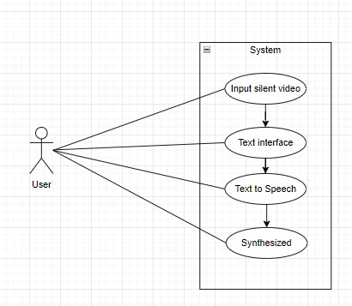
UML Diagrams
Use case diagram:
A use case diagram is a form of behavioral diagram specified by and derived from a Use-case analysis in the Unified Modeling Language (UML). Its goal is to offer a graphical representation of a system's functionality
Use Case Diagram of the project from user view. User provides the system a silent video and from that text will be generated and converted into speech and saved in form an audio file.

Slide 15
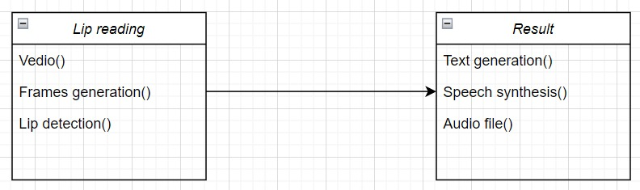
UML Diagrams
Class diagram:
Classes used for this project and link between them and each class contain code for output.
Lip Reading:
Video () – Input the silent video.
Frame generation () – Converts the video into frames.
Lip detection () – generation of movements.
Result:
Text generation () – generation of text from lip movements.
Speech Synthesis () – speech is generated from gtts.
Audio file () – saved in file.

Slide 16
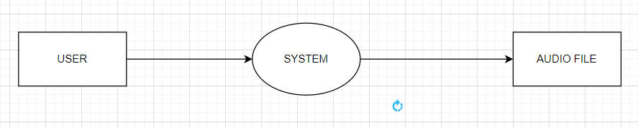
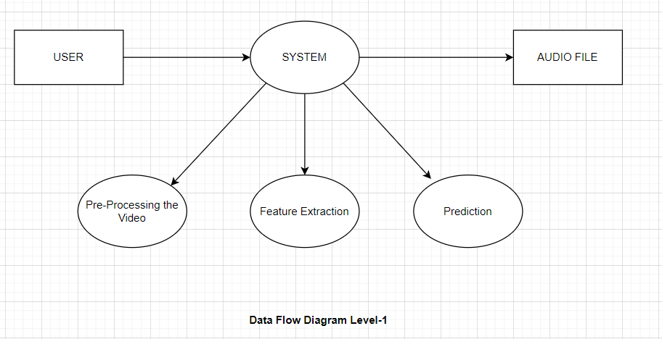
UML Diagrams
Data flow diagram:
level - 0
level - 1

Slide 17
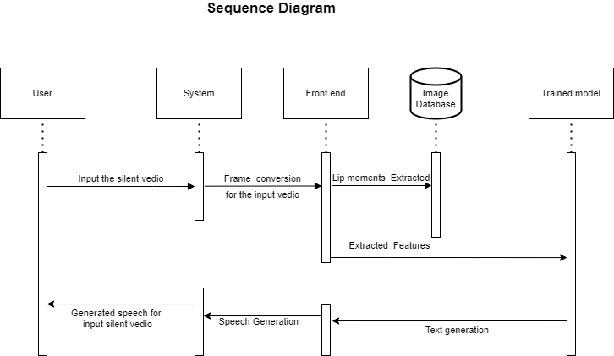
UML Diagrams
SEQUENCE DIAGRAM:
It represents the sequence diagram in this project, it clearly shows the order in which the execution goes like clear steps from where data is loaded the classes it goes into etc.

Slide 18
Design Steps
Training:
Step-1: Data is pre-processed, lip pictures are formed, and associated sign language vocabulary is saved in a speech training database.
Step-2: Each image is adjusted to the desired size and saved.
Step-3: NumPy arrays are created from images.
Step-4: Training and testing data are separated.
Step-5: The model is built using thick, pooling layers, and other techniques.
Step-6: The model is trained over a specified number of epochs.
Step-7: The model is saved, and the correctness is determined using the testing data.

Slide 19
Design Steps
Testing:
Step-1: The input is a silent video.
Step-2: The video is supplied to a function that converts it to an image stream.
Step-3: All photos are provided to the 'to Frames' function, which only saves images that have lips.
Step-4: Images are pre-processed and delivered to a model, which guesses which class they belong to and saves their value.
Step-5: After that, the text is sent to the gTTs module, which translates it to voice and saves it as an audio file.

Slide 20
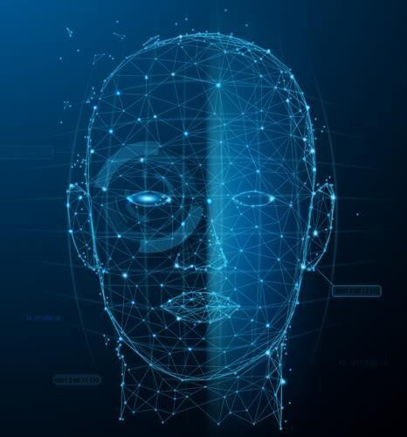
Facial Recognition
Facial recognition helps to identify the lips.

Slide 21
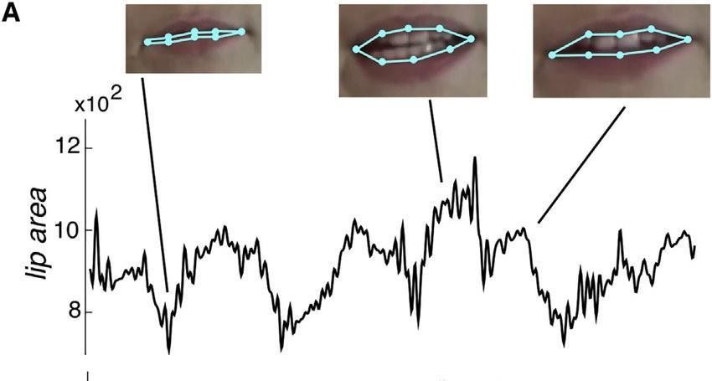
Detecting the Word
From the movement of lip it takes the co-ordinates and recognizes the words.

Slide 22
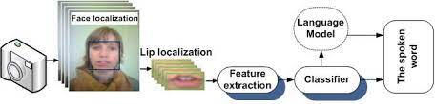
Generation of Speech
After recognizing the words the speech is generated any produced continuously to sync with the video.

Slide 23
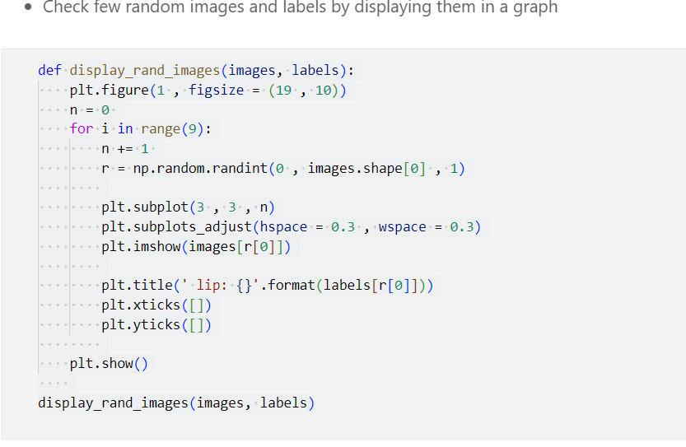
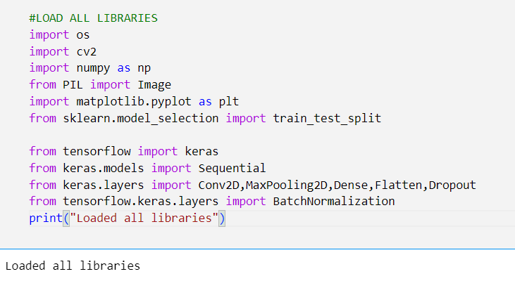
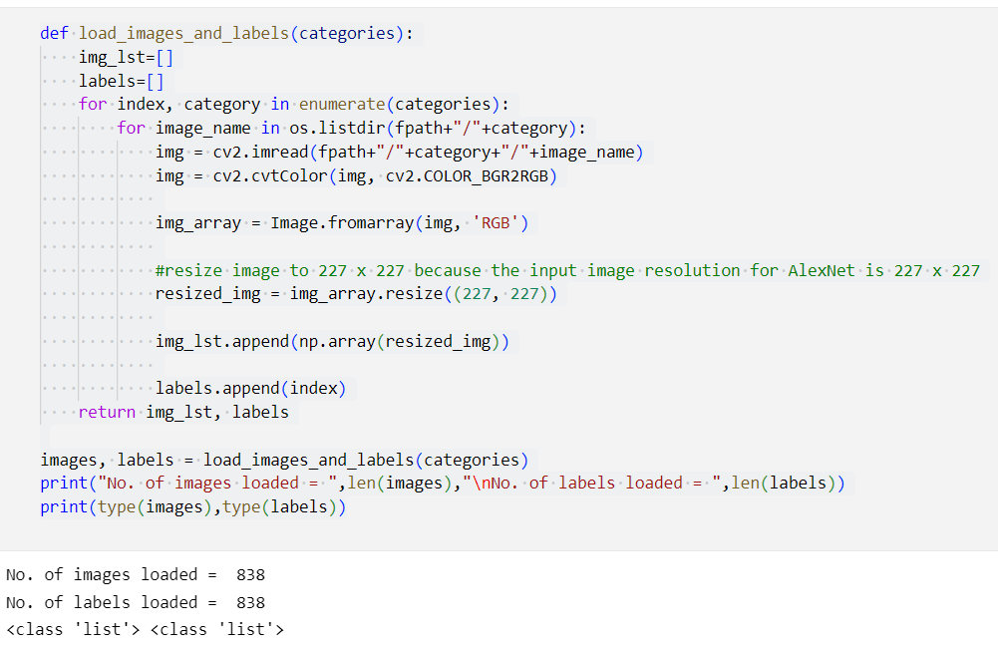
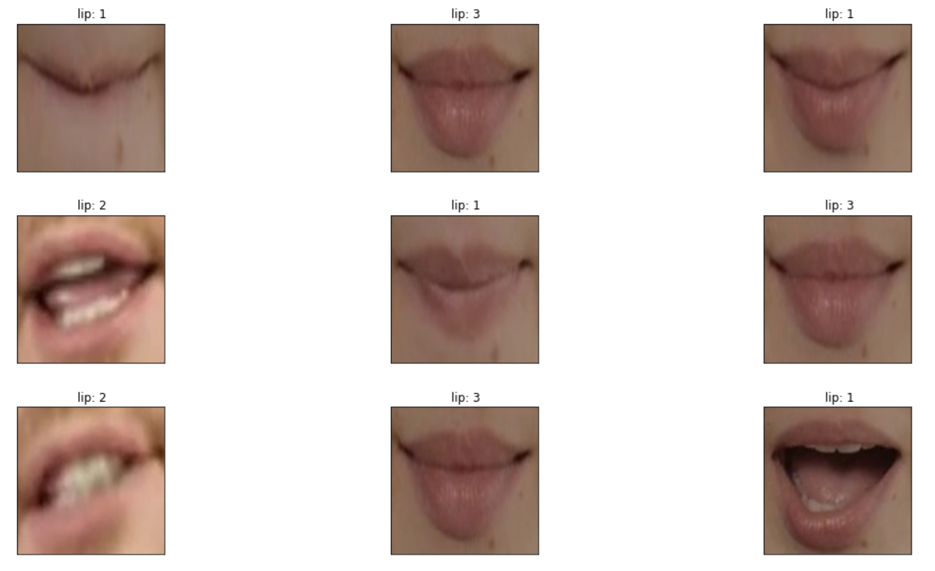
Code
Training:

Slide 24
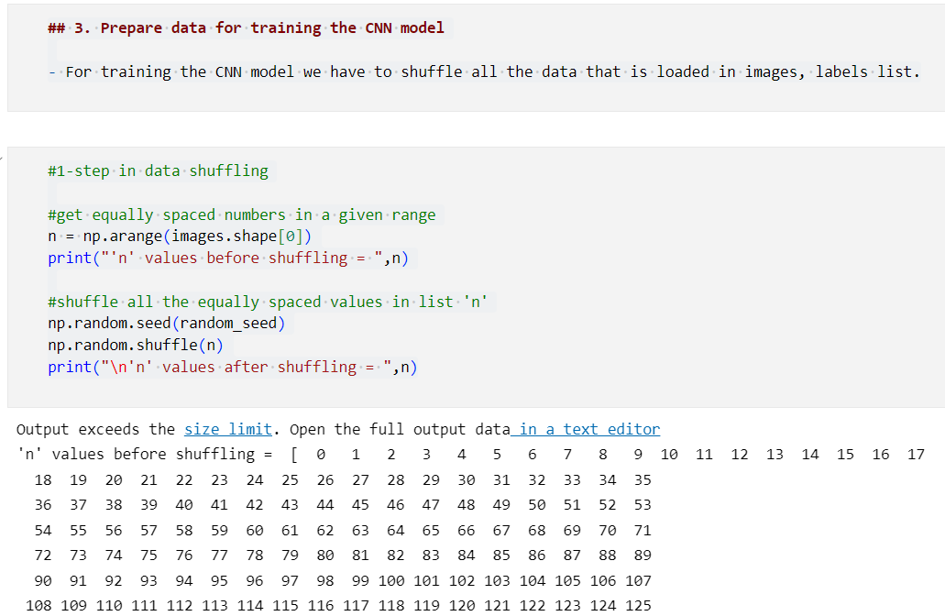
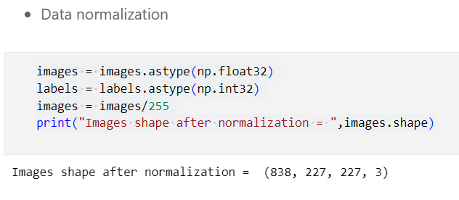
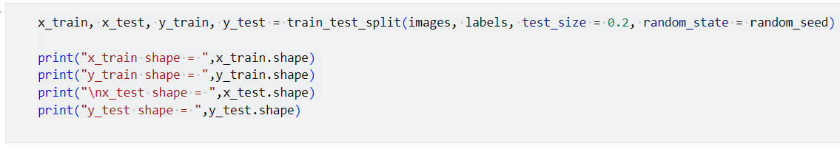
Split the loaded dataset into train, test sets

Slide 25
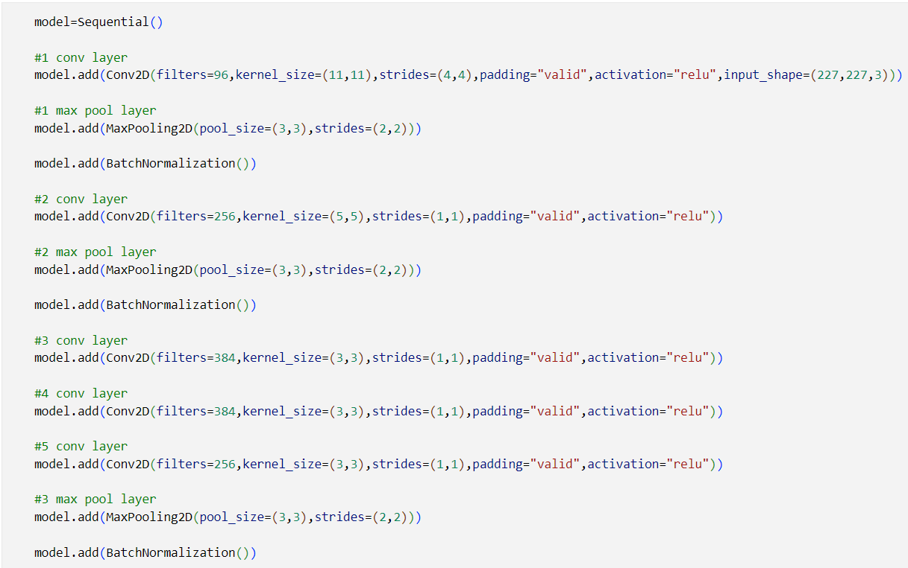
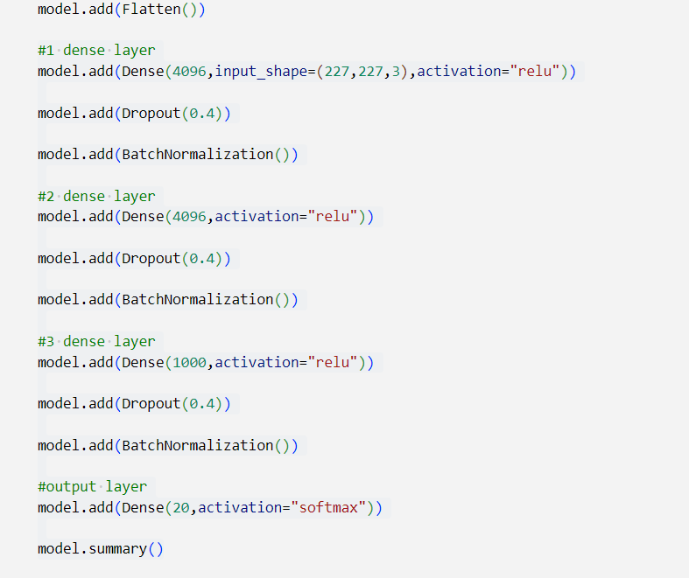
Define all layers in the AlexNet CNN model:

Slide 26
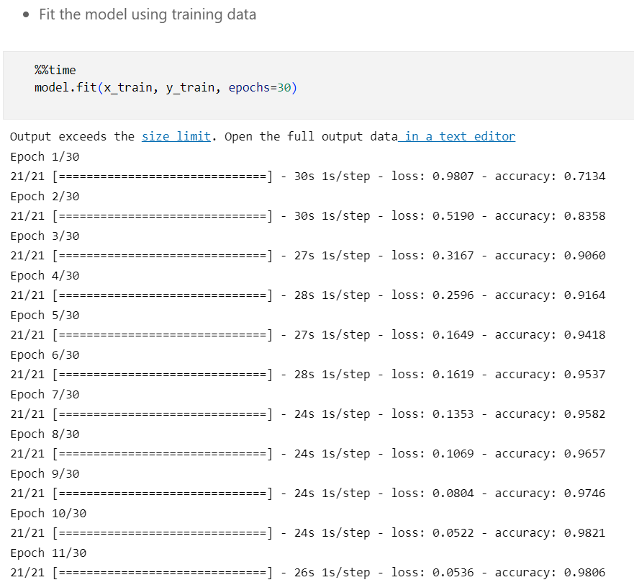
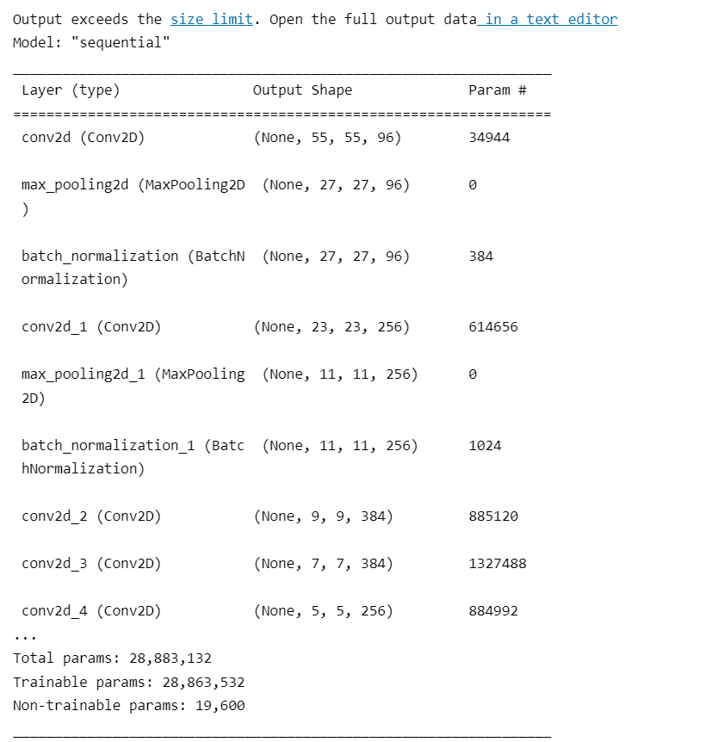
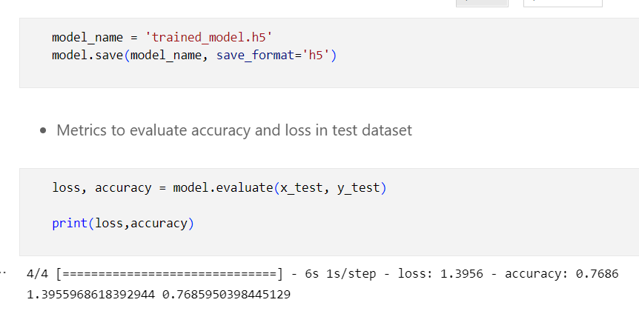

Slide 27
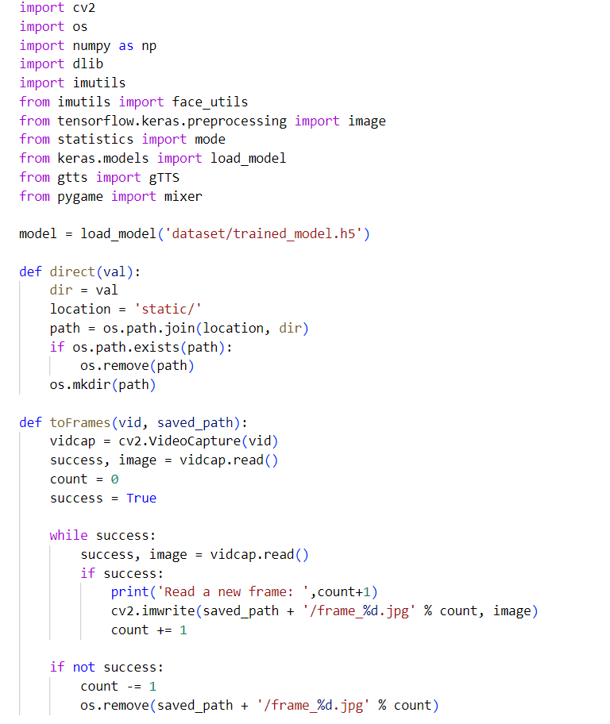
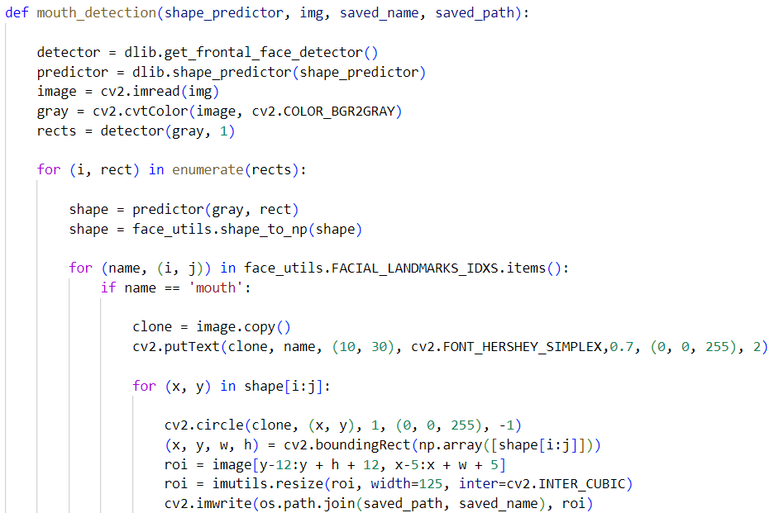
Testing:

Slide 28
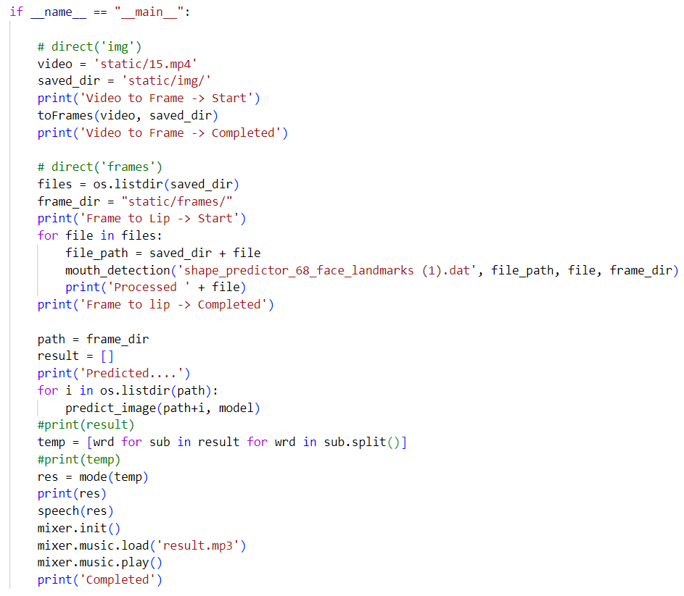
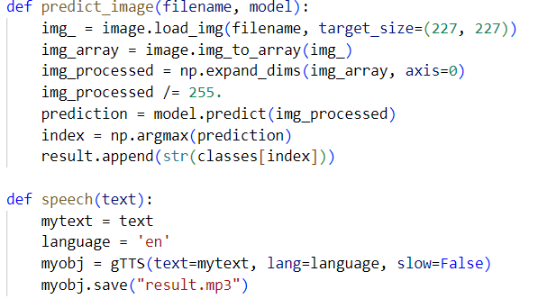

Slide 29
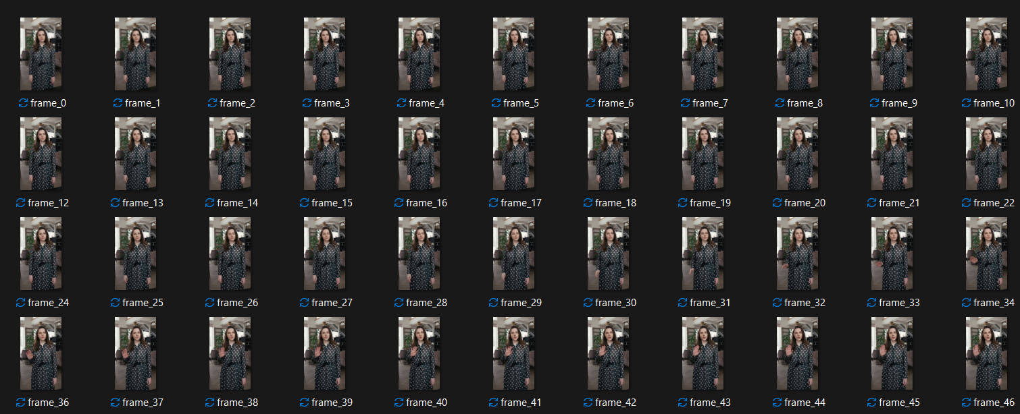
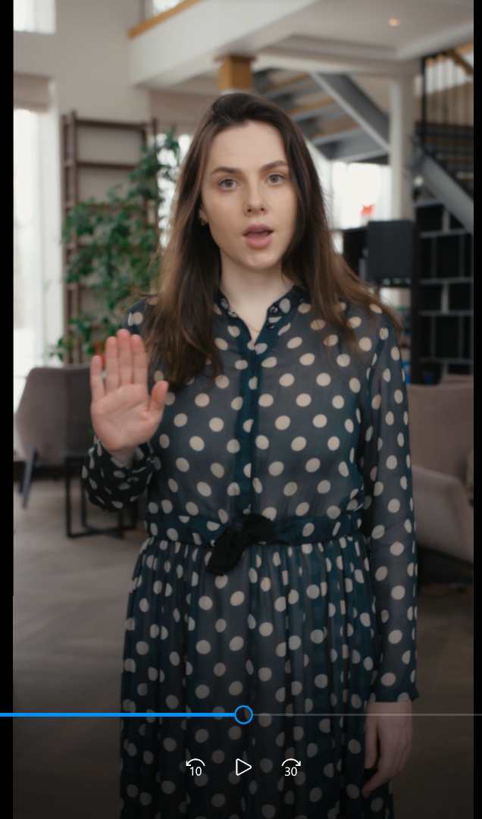
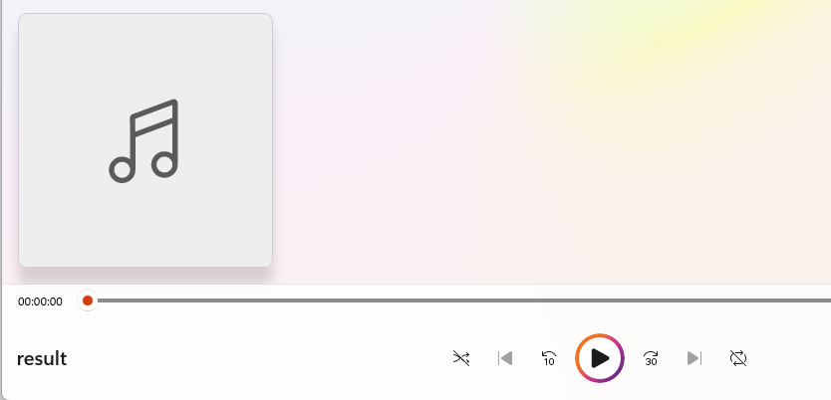
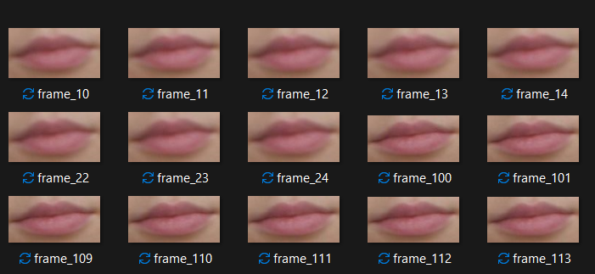
Results
Input silent video:
Frames converted from video
Output Audio file
Lip movements generated from frames

Slide 30
Applications
Important meetings and Video call in noisy environments.
Long-Range listening for Surveillance where the voice of people may not be clearly captured.
Generating voice for people who cannot speak.
Generating speech from video where there is loss of sound.

Slide 31
Conclusion
This project looks on the advancement of lip identification and recognition, which achieves significantly better results than previously proposed methods. Different lip motions are used to detect and recognise words automatically. We describe a method for identifying and distinguishing various human lip expressions. The suggested system's goal is to provide a technique that automatically detects the human lip and recognises various lip expressions. Shape characteristics are used to extract feature values. The distinct lip expressions of the human were further categorised using the CNN algorithm based on the specified attributes and measured region parameters of the lip.
• It is limited to the English language.
• It necessitates more data and preprocessing for training in order to achieve better results;
• It necessitates more computer capacity in order to provide output rapidly.

Slide 32
Future Work
Taking word sequencing into account in the neural network to distinguish words with similar lip shapes can improve results in lip reading. Accuracy is improved by applying model architecture to different languages and fine-tuning more complicated algorithms. A data set can be used to train a more robust lip-reading algorithm. Similarly, higher computer architecture or parallel computing can be used to train the lightweight model architecture. Similarly, with the ability to lip read phrases, the model can be taught for improved accuracy.

Slide 33
References
[1] J. Hong, M. Kim, S. J. Park and Y. M. Ro, "Speech Reconstruction with Reminiscent Sound via Visual Voice Memory," in IEEE/ACM Transactions on Audio, Speech, and Language Processing, doi: 10.1109/TASLP.2021.3126925.
[2] M. S. Ribeiro et al., "Tal: A Synchronised Multi-Speaker Corpus of Ultrasound Tongue Imaging, Audio, and Lip Videos," 2021 IEEE Spoken Language Technology Workshop (SLT), 2021, pp. 1109- 1116, doi: 10.1109/SLT48900.2021.9383619.
[3] R. Varghese, R. M. Cherian, S. R. Ninan, N. Arun and V. K. Anjusree, "Automatic Voice Synthesis System using Long Short-Term Memory and Google Mediapipe," 2021 12th International Conference on Computing Communication and Networking Technologies (ICCCNT), 2021, pp. 1-5, doi: 10.1109/ICCCNT51525.2021.9579837.
[4] D. Michelsanti et al., "An Overview of Deep-Learning-Based Audio-Visual Speech Enhancement and Separation," in IEEE/ACM Transactions on Audio, Speech, and Language Processing, vol. 29, pp. 1368-1396, 2021, doi: 10.1109/TASLP.2021.3066303.

Slide 34
[5] K. Matsui, K. Fukuyama, Y. Nakatoh and Y. O. Kato, "Speech Enhancement System Using Lip- reading," 2020 IEEE 2nd International Conference on Artificial Intelligence in Engineering and Technology (IICAIET), 2020, pp. 1-5, doi: 10.1109/IICAIET49801.2020.9257839.
[6] O. Perrotin and I. V. McLoughlin, "Glottal Flow Synthesis for Whisper-to-Speech Conversion," in IEEE/ACM Transactions on Audio, Speech, and Language Processing, vol. 28, pp. 889-900, 2020, doi: 10.1109/TASLP.2020.2971417.
[7] H. X. Pham, Y. Wang and V. Pavlovic, "Learning Continuous Facial Actions from Speech for Real-time Animation," in IEEE Transactions on Affective Computing, doi: 10.1109/TAFFC.2020.3022017.
[8] S. Lesaja, C. Herff, G. D. Johnson, J. J. Shih, T. Schultz and D. J. Krusienski, "Decoding Lip Movements During Continuous Speech using Electrocorticography," 2019 9th International IEEE/EMBS Conference on Neural Engineering (NER), 2019, pp. 522-525, doi: 10.1109/NER.2019.8716914.

Slide 35
[9] H. Akbari, H. Arora, L. Cao and N. Mesgarani, "Lip2Audspec: Speech Reconstruction from Silent Lip Movements Video," 2018 IEEE International Conference on Acoustics, Speech and Signal Processing (ICASSP), 2018, pp. 2516-2520, doi: 10.1109/ICASSP.2018.8461856.
[10] Z. Naraghi and M. Jamzad, "Speech driven lips animation for the Farsi language," 2015 The International Symposium on Artificial Intelligence and Signal Processing (AISP), 2015, pp. 201-205, doi: 10.1109/AISP.2015.7123525.

Slide 36


